Slide 1
Lead Scoring Case Study
Submitted By:
Akshay R
Bharath HC
Lekha Sharma
(Upgrad & IIIT-B)

Slide 2
Table Of Content
Problem Statement
Visualization of important features and insights
Evaluation metrics
Business Recommendations

Slide 3
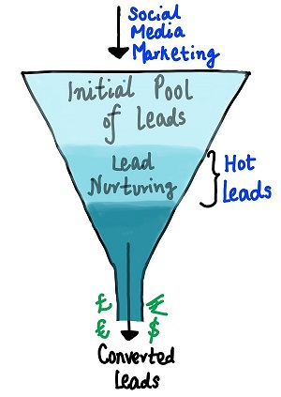
Problem Statement
An education company named X Education sells online courses to industry professionals. On any given day, many professionals who are interested in the courses land on their website and browse for courses.
Now, although X Education gets a lot of leads, its lead conversion rate is very poor. To make this process more efficient, the company wishes to identify the most potential leads, also known as ‘Hot Leads’. If they successfully identify this set of leads, the lead conversion rate should go up as the sales team will now be focusing more on communicating with the potential leads rather than making calls to everyone. A typical lead conversion process can be represented using the funnel.

Slide 4
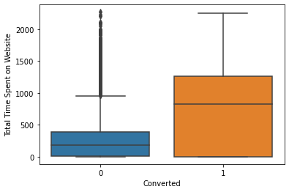
Visualization of important features and insights
Total time spent on website
As can be seen, leads spending more time on website are more likely to convert , thus website should be made more engaging to increase conversion rate.

Slide 5
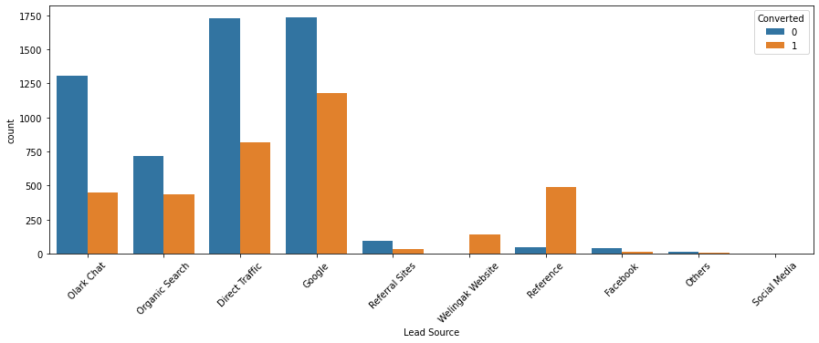
Lead Source
Inference
Maximum Leads are generated by Google and Direct Traffic.
Conversion rate of Reference leads and Welinkgak Website leads is very high.

Slide 6
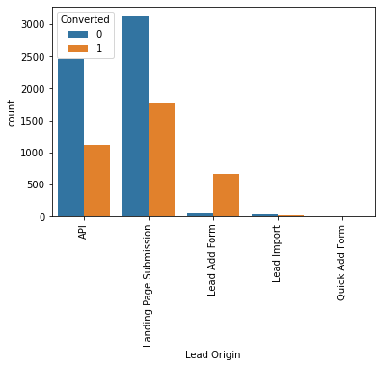
Lead Origin
Inference
Lead add form has more then 90% conversion rate. If the origin of leads is from add form, then there is higher probability that lead would convert.

Slide 7
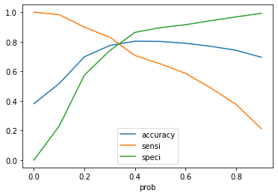
Evaluation Metrics
Measure | Train set | Test set
Accuracy | 77.45% | 77.99%
Sensitivity | 83.00% | 84.38%
Specificity | 74.03% | 73.82%
Hence, we can see that the final prediction of conversions have a target of 83% conversion. Hence, we can say that this is a good model.

Slide 8
Business Recommendations
To improve overall lead conversion rate, we need to focus more on improving lead conversion of API and Landing Page Submission origin and generate more leads from Lead Add Form.
As we saw customer spends more time on website thus website should be made more engaging to increase conversion rate.
To improve overall lead conversion rate, focus should be on improving lead conversion of olark chat, organic search, direct traffic, and google leads and generate more leads from reference and welingak website.

Slide 9


